Slide 1
Taken and Tried
2024 Quarter 3 Lesson 11
Mark 14:1-72

Slide 2
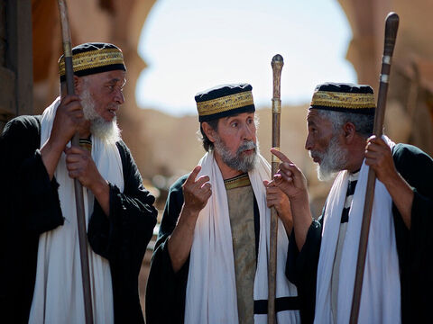
The Plot
Mark 14:1-2
14 After two days was the feast of the passover, and of unleavened bread: and the chief priests and the scribes sought how they might take him by craft, and put him to death.

Slide 3
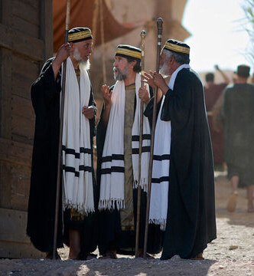
The Plot
Mark 14:1-2
2 But they said, Not on the feast day, lest there be an uproar of the people.

Slide 4
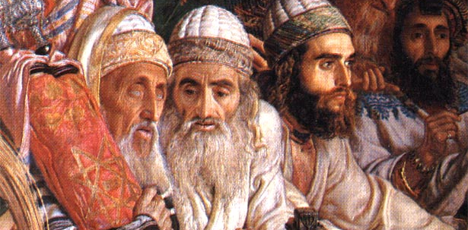
An UPROAR
Popular sentiment among the throngs gathered in Jerusalem to celebrate the Passover, the event that marked Israel’s first deliverance as a nation, was strongly in favor of proclaiming Jesus as Messiah-King. It would not be safe, the leaders reasoned, to deal with Jesus until these crowds should have departed from the city. But, their deliberations having reached this point, Judas came with a proposal that apparently changed their plans.

Slide 5
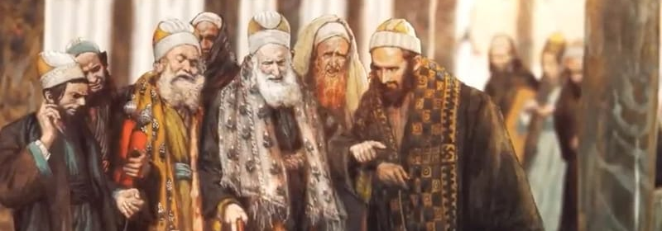
An UPROAR
It seems that Matthew (and Mark) here inserts the narrative of the feast at Simon’s house, which took place in Bethany, while the priests and Pharisees were in council in the palace of Caiaphas in Jerusalem, by way of explaining the change in plans. Following the rebuke received at this feast Judas went directly to the palace, and there arranged to betray Jesus.

Slide 6
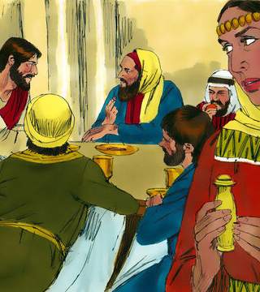
A Plan
3 And being in Bethany in the house of Simon the leper, as he sat at meat, there came a woman having an alabaster box of ointment of spikenard very precious; and she brake the box, and poured it on his head.

Slide 7

A Plan (DA 558)
[Mary] had heard Jesus speak of His approaching death, and in her deep love and sorrow she had longed to show Him honor. At great personal sacrifice she had purchased an alabaster box of “ointment of spikenard, very costly,” with which to anoint His body. But now many were declaring that He was about to be crowned king.

Slide 8
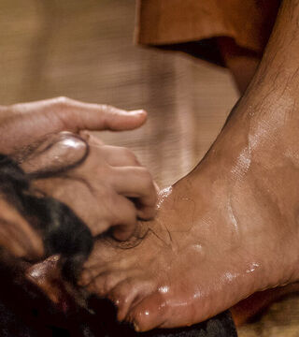
A Plan (DA 558)
Her grief was turned to joy, and she was eager to be first in honoring her Lord. Breaking her box of ointment, she poured its contents upon the head and feet of Jesus; then, as she knelt weeping, moistening them with her tears, she wiped His feet with her long, flowing hair.

Slide 9

A Plan (DA 559)
She had sought to avoid observation, and her movements might have passed unnoticed, but the ointment filled the room with its fragrance, and published her act to all present. Judas looked upon this act with great displeasure.

Slide 10
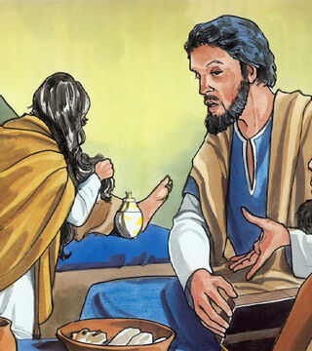
A Plan
4 And there were some that had indignation within themselves, and said, Why was this waste of the ointment made?
5 For it might have been sold for more than three hundred pence, and have been given to the poor. And they murmured against her.

Slide 11
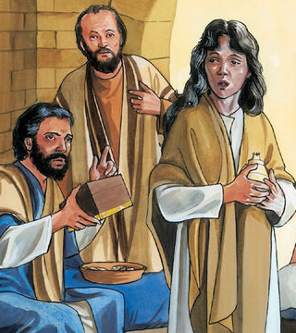
A Plan
4 And there were some that had indignation within themselves, and said, Why was this waste of the ointment made?
5 For it might have been sold for more than three hundred pence, and have been given to the poor. And they murmured against her.

Slide 12
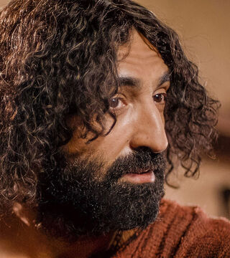
A Plan (DA 560)
Mary heard the words of criticism. Her heart trembled within her. She feared that her sister would reproach her for extravagance. The Master, too, might think her improvident. Without apology or excuse she was about to shrink away, when the voice of her Lord was heard, “Let her alone; why trouble ye her?”

Slide 13
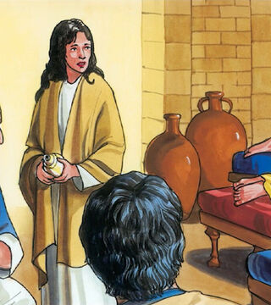
A Plan
6 And Jesus said, Let her alone; why trouble ye her? she hath wrought a good work on me.
7 For ye have the poor with you always, and whensoever ye will ye may do them good: but me ye have not always.

Slide 14
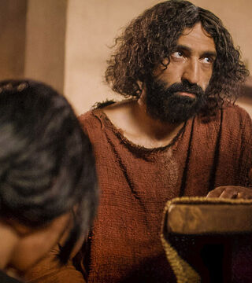
A Plan (DA 560)
He saw that she was embarrassed and distressed. He knew that in this act of service she had expressed her gratitude for the forgiveness of her sins, and He brought relief to her mind. Lifting His voice above the murmur of criticism, He said, “She hath wrought a good work on Me.

Slide 15
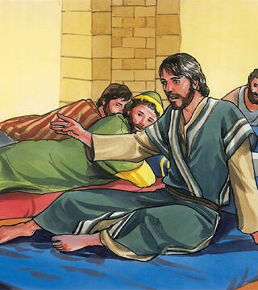
A Plan
8 She hath done what she could: she is come aforehand to anoint my body to the burying.

Slide 16
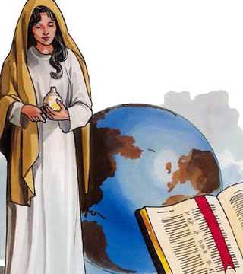
A Plan
9 Verily I say unto you, Wheresoever this gospel shall be preached throughout the whole world, this also that she hath done shall be spoken of for a memorial of her.

Slide 17
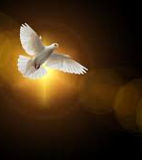
A Plan (DA 560)
Mary knew not the full significance of her deed of love. She could not answer her accusers. She could not explain why she had chosen that occasion for anointing Jesus.

Slide 18
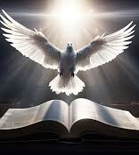
A Plan (DA 560)
The Holy Spirit had planned for her, and she had obeyed His promptings. Inspiration stoops to give no reason. An unseen presence, it speaks to mind and soul, and moves the heart to action. It is its own justification.

Slide 19
The Plot
Mark 14:10-11
10 And Judas Iscariot, one of the twelve, went unto the chief priests, to betray him unto them.
11 And when they heard it, they were glad, and promised to give him money. And he sought how he might conveniently betray him.

Slide 20

The Plot (DA 563)
Christ had rebuked Judas. Prior to this, the Saviour had never given him a direct rebuke. Now the reproof rankled in his heart. He determined to be revenged.

Slide 21
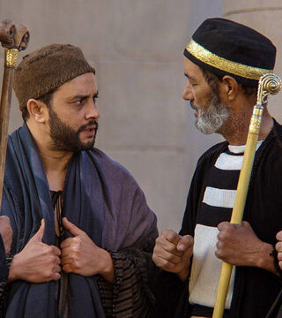
The Plot (DA 563)
From the supper he went directly to the palace of the high priest, where he found the council assembled, and he offered to betray Jesus into their hands.

Slide 22
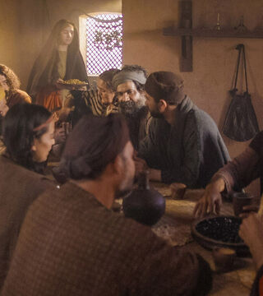
The Plot (DA 564)
The disciples were not like Judas. They loved the Saviour. But they did not rightly appreciate His exalted character. Had they realized what He had done for them, they would have felt that nothing bestowed upon Him was wasted.

Slide 23
The Plot (DA 564)
Acts of love and reverence for Jesus are an evidence of faith in Him as the Son of God. And the Holy Spirit mentions, as evidences of woman's loyalty to Christ: “If she have washed the saints’ feet, if she have relieved the afflicted, if she have diligently followed every good work.” 1 Timothy 5:10.

Slide 24
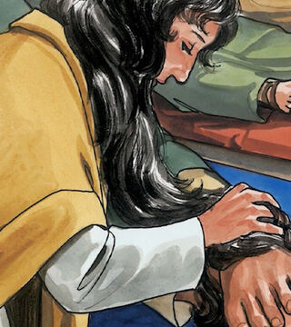
The Plot (DA 565)
The work of Mary was just the lesson the disciples needed to show them that the expression of their love for Him would be pleasing to Christ.

Slide 25
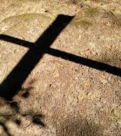
The Plot (DA 565)
He had been everything to them, and they did not realize that soon they would be deprived of His presence, that soon they could offer Him no token of their gratitude for His great love.

Slide 26
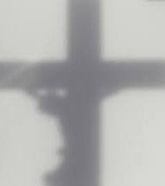
The Plot (DA 565)
Oh, if they could have taken back their censuring, their presenting the poor as more worthy of the gift than was Christ! They felt the reproof keenly as they took from the cross the bruised body of their Lord.

Slide 27
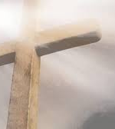
The Plot (DA 565)
The same want is evident in our world today. But few appreciate all that Christ is to them. If they did, the great love of Mary would be expressed, the anointing would be freely bestowed.

Slide 28
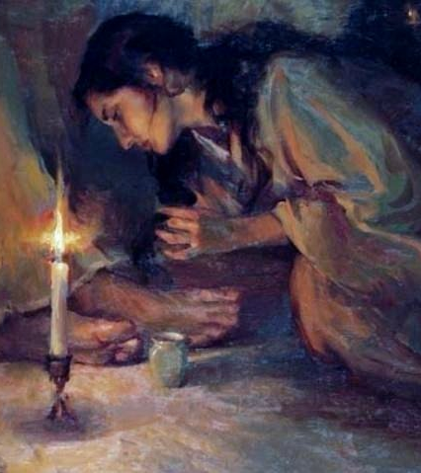
The Plot (DA 565)
The expensive ointment would not be called a waste. Nothing would be thought too costly to give for Christ, no self-denial or self-sacrifice too great to be endured for His sake.

Slide 29
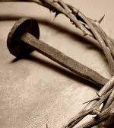
The Plot (DA 565)
The words spoken in indignation, “To what purpose is this waste?” brought vividly before Christ the greatest sacrifice ever made,—the gift of Himself as the propitiation for a lost world. The Lord would be so bountiful to His human family that it could not be said of Him that He could do more.

Slide 30
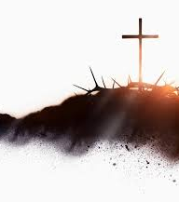
The Plot (DA 565)
In the gift of Jesus, God gave all heaven. From a human point of view, such a sacrifice was a wanton waste. To human reasoning the whole plan of salvation is a waste of mercies and resources.

Slide 31
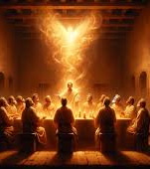
The Plot (DA 565)
But the atonement for a lost world was to be full, abundant, and complete. Christ's offering was exceedingly abundant to reach every soul that God had created. It could not be restricted so as not to exceed the number who would accept the great Gift.

Slide 32

The Plot (DA 565)
All men are not saved; yet the plan of redemption is not a waste because it does not accomplish all that its liberality has provided for. There must be enough and to spare.

Slide 33
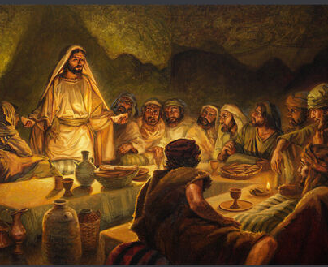
The Last Supper
Mark 14:12-26
12 And the first day of unleavened bread, when they killed the passover, his disciples said unto him, Where wilt thou that we go and prepare that thou mayest eat the passover?

Slide 34
The Passover—The Problem
SDA Bible Commentary p. 532
“
All four Gospels agree that Jesus and His disciples celebrated the Last Supper on the night preceding the crucifixion, that He lay in the tomb over Sabbath, and that He arose early Sunday morning. The Synoptics, however, call the Last Supper, the night preceding the crucifixion, “the Passover,” whereas according to John, the Jews celebrated the Passover supper on the night following the crucifixion. The statements of John and the Synoptics thus appear to be in conflict.
”

Slide 35
The Passover—The Problem
Mark 14:12
And the first day of unleavened bread, when they killed the passover, his disciples said unto him, Where wilt thou that we go and prepare that thou mayest eat the passover?
Matthew 26:17
17 Now the first day of the feast of unleavened bread the disciples came to Jesus, saying unto him, Where wilt thou that we prepare for thee to eat the passover?

Slide 36
The Passover—The Problem
Luke 22:7-8
7 Then came the day of unleavened bread, when the passover must be killed.
8 And he sent Peter and John, saying, Go and prepare us the passover, that we may eat.
John 19:14-15
14 And it was the preparation of the passover, and about the sixth hour: and he saith unto the Jews, Behold your King!
15 But they cried out, Away with him, away with him, crucify him. Pilate saith unto them, Shall I crucify your King? The chief priests answered, We have no king but Caesar.

Slide 37
The Passover—The Problem
John 13:1
13 Now before the feast of the passover, when Jesus knew that his hour was come that he should depart out of this world unto the Father, having loved his own which were in the world, he loved them unto the end.
John 18:28
28 Then led they Jesus from Caiaphas unto the hall of judgment: and it was early; and they themselves went not into the judgment hall, lest they should be defiled; but that they might eat the passover.

Slide 38
The Passover—The Things We KNOW
SDA Bible Commentary p. 533
“
TIME OF THE PASSOVER:
  The paschal lamb was slain in the late afternoon of Nisan 14, following the regular evening sacrifice, and eaten, with unleavened bread, after sunset that same night, during the early hours of Nisan 15 (Ex. 12:6-14, 29, 33, 42, 51 ; 13 :3— 7; Num. 9:1-5; 33:3; Deut. 16:1-7).
”

Slide 39
The Passover—The Things We KNOW
SDA Bible Commentary p. 533
“
Nisan 15, a ceremonial sabbath, also marked the beginning of the Feast of Unleavened Bread (Ex. 12:8, 18, 34, 39; Lev. 23:5, 6; Num. 28:16, 17; Deut. 16:3, 4, 8).
On Nisan 16, the second day of this feast, the wave sheaf of the first fruits was presented in the Temple (see Lev. 23:10-14; also Josephus’ Antiquities iii. 10. 5 [250, 251]).
”

Slide 40
The Passover—The Things We KNOW
SDA Bible Commentary p. 533
“
The term “Passover” was originally applied to Nisan 14 only, but in the time of Christ it was sometimes used of the Feast of Unleavened Bread as well (Josephus’ Antiquities ii. 14. 6; xi. 4. 8; xiv.2. 1 [311-313; 109-111; 21]; xvii. 9. 3; War ii. 1.3; v. 3. 1 [10; 99]).
Apparently, also, the term Feast of Unleavened Bread was similarly used to include the Passover (Luke 22:7; Acts 12:3, 4; cf. Ch. 20:6).
”

Slide 41
The Passover—The Things We KNOW
SDA Bible Commentary p. 533-534
“
The crucifixion took place on “the preparation [eve] of the passover,” that is, on Nisan 14 (John 19:14; cf. Talmud Pesahim 58a, Soncino ed., p.288; Sanhedrin 43a, Soncino ed., p. 281; Ex. 12:6; cf. GC 399).
The death of Christ took place on a Friday afternoon (Mark 1 5:42 to 16:2; Luke 23:54 to 24:1; John 19:31, 42, 20:1), about the time of the evening sacrifice (DA 756,757; cf. GC 399).
”

Slide 42
The Passover—The Things We KNOW
SDA Bible Commentary p. 534
“
Accordingly, in the year of the crucifixion, Nisan 14, the day appointed for slaying the paschal lambs, fell on a Friday; the preparation for (or eve of) the Passover coincided with the preparation for (or eve of) the weekly Sabbath (John 19:14; cf. vs. 3 1, 42; ch. 20:1).
”

Slide 43
The Passover—The Things We KNOW
SDA Bible Commentary p. 534
“
The first ceremonial sabbath of the Feast of Unleavened Bread, Nisan 15, thus coincided with the weekly Sabbath (Lev. 23:6-8; cf. Mark 15:42 to 16:2; Luke 23:5 to 24:1).
”

Slide 44
The Passover—The Things We KNOW
SDA Bible Commentary p. 534
“
The Last Supper took place the night preceding the crucifixion (Matt. 26:1 7, 20, 26, 34, 47; Mark 14:12, 16, 17; 22:7, 8, 13-15; John 13:2, 4, 30; 14:31; 18:1-3,28;19:16; cf. DA 642; GC 399), that is, during the early hours of Nisan 14 and thus on a Thursday night.
”

Slide 45
The Passover—The Things We KNOW
SDA Bible Commentary p. 534
“
The synoptic accounts call the Last Supper a Passover supper (Matt. 26:17, 20; Mark 14:12, 16, 17; Luke 22:7, 8, 13-15; cf. DA 642, 652; GC 399).
”

Slide 46
The Passover—The Things We KNOW
SDA Bible Commentary p. 534
“
John’s account places the official Jewish celebration of the Passover supper 24 hours later than the Last Supper, and thus on Friday night following the crucifixion, during the early hours of the weekly Sabbath (John 18:28; 19:14, 31; cf. DA 774), which would be Nisan 15.
”

Slide 47
The Passover—The Things We KNOW
SDA Bible Commentary p. 534
“
At the time of the Last Supper (John 13:1), during the course of the trial (Matt. 26:5; Mark 14:2; John 18:28; 19:14; cf. DA 703, 723), and on the way to Calvary (cf. DA 742), the official celebration of the Passover was apparently yet future.
”

Slide 48
The Passover—The Things We KNOW
SDA Bible Commentary p. 534
“
Jesus lay in the tomb over the Sabbath (Matt. 27:59 to 28:1; Mark 15:43 to 16:1; Luke 23:54 to 24:1; John 19:38 to 20:1), which would be Nisan 15.
”

Slide 49
The Passover—The Things We KNOW
SDA Bible Commentary p. 534
“
Jesus arose from the tomb early Sunday morning, Nisan 16 (Matt. 28:1-6; Mark 16:1-6; Luke 24:1-6; John 20:1-16; see on Mark 15:42, 46; cf. GC 399; DA 785, 786).
”

Slide 50
The Passover—The Anti-Type
SDA Bible Commentary p. 534
“
The paschal lamb prefigured Christ, “the Lamb of God, which taketh away the sin of the world” (John 1 :29), “Christ our passover,” who was to be “sacrificed for us” (1 Cor. 5:7). Similarly, the wave sheaf of the Feast of Unleavened Bread typified “Christ risen from the dead, ... the first-fruits of them that slept” (1 Cor. 15:20,23).
”

Slide 51
The slaying of the Passover lamb was a shadow of the death of Christ. Says Paul: “Christ our Passover is sacrificed for us.” 1 Corinthians 5:7. The sheaf of first fruits, which at the time of the Passover was waved before the Lord, was typical of the resurrection of Christ.
The Great Controversy p. 399

Slide 52
Paul says, in speaking of the resurrection of the Lord and of all His people: “Christ the first fruits; afterward they that are Christ's at His coming.” 1 Corinthians 15:23. Like the wave sheaf, which was the first ripe grain gathered before the harvest, Christ is the first fruits of that immortal harvest of redeemed ones that at the future resurrection shall be gathered into the garner of God.
The Great Controversy p. 399

Slide 53
These types were fulfilled, not only as to the event, but as to the time. On the fourteenth day of the first Jewish month, the very day and month on which for fifteen long centuries the Passover lamb had been slain, Christ, having eaten the Passover with His disciples, instituted that feast which was to commemorate His own death as “the Lamb of God, which taketh away the sin of the world.”
The Great Controversy p. 399

Slide 54
The Passover—The Wednesday Theory
SDA Bible Commentary p. 534
“
The Wednesday Crucifixion Theory
This theory is based on several problematic assumptions:
First, that the Christian Era date of the paschal full moon of the crucifixion year can be determined with absolute accuracy. This is simply not true.
”

Slide 55
The Passover—The Wednesday Theory
SDA Bible Commentary p. 534
“
Lunar Calendar Dating Problems
Tables that purport to give the Christian Era dates for each paschal full moon during the ministry of our Lord are of no real help in this problem for all such tables are based on modem Jewish methods of computing the time of the Passover.
”

Slide 56
The Passover—Proposed Solutions
SDA Bible Commentary p. 534
“
Lunar Calendar Dating Problems
How the Jews of Christ’s time coordinated their lunar calendar with the solar year is not known today, all supposedly learned statements to the contrary notwithstanding. It is therefore impossible to determine with absolute certainty the day of the week or even, always, the month in which the Passover of any year of our Lord’s ministry may have occurred.
”

Slide 57
The Passover—The Wednesday Theory
SDA Bible Commentary p. 534
“
The Wednesday theory assumes that the Hebrew idiomatic expression “three days and three nights” indicates a period of 72 full hours. This needn’t be the case. The common mode of counting employed in the Bible seems to have been inclusive reckoning, that is, counting both the first and the last unit of time in calculating an interval.
”

Slide 58
The Passover—The Wednesday Theory
SDA Bible Commentary p. 534
“
Consider Acts 10. Here Cornelius received his vision and dispatched his servants on the first day of (vs. 3, 7, 8); they arrived at Joppa on the second day (vs. 9, 17); they, with Peter and his friends, left Joppa on the third day (v. 23); and all arrived at Caesarea on the fourth day (v. 24). Since they met Cornelius at about the same hour as he had had his vision, the total period could have been scarcely more than 72 hours, yet because parts of four days were involved Cornelius spoke of it as “four days.”
”

Slide 59
The Passover—The Wednesday Theory
SDA Bible Commentary p. 534
“
Inclusive Time Reckoning
A Hebrew boy was circumcised when “eight days old” (Gen. 17:12), that is, “in the eighth day” (Lev. 12:3). Similarly Luke speaks of circumcision “on the eighth day” or “when eight days were accomplished” (Luke 1:59; 2:21). Evidently “when eight days were accomplished” (or “at the end of eight days,” RSV) does not mean eight full days from the date of birth, but eight inclusive.
”

Slide 60
The Passover—The Wednesday Theory
SDA Bible Commentary p. 534
“
Inclusive Time Reckoning
There are other examples. When, at the death of Solomon, Rehoboam was petitioned to lighten the tax burden, he told the people to depart “for three days” (1 Kings 12:5) and then return for his decision “after three days” (2 Chron. 10:5). They came “the third day, as the king had appointed, saying, Come to me again the third day” (1 Kings 12:12; cf. 2 Chron. 10:12).
”

Slide 61
The Passover—The Wednesday Theory
SDA Bible Commentary p. 534
“
Inclusive Time Reckoning
Esther asked the Jews of Shushan to fast, and by implication, to pray, for her before she went in to the king unbidden, and then she approached the king “on the third day” (Esther 4:16; 5:1). Obviously a period of “three days” ended on the third day, not after the completion of the three days, as we would reckon it.
”

Slide 62
The Passover—The Wednesday Theory
SDA Bible Commentary p. 534
“
The Wednesday theory also assumes the Greek of Matt. 28:1 assigns the resurrection to Sabbath afternoon. This theory does not bear the marks of sound scholarship and is utterly at variance with Biblical meanings of terms. Therefore it is untenable.
”

Slide 63
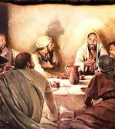
Proposed Solution #1:
Not the Passover
When referring to the Last Supper, the synoptic writers describe, not the Passover meal, but a ceremonial meal that preceded it by 24 hours. According to this assumption Nisan 14 fell on Friday in the year of the crucifixion and the Passover of John was the official Passover meal.

Slide 64
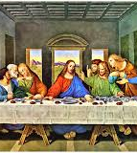
Proposed Solution #1:
Not the Passover
This approach assumes that the Synoptics use the word “passover” in an accommodated sense. While it may be granted that the word “passover” could have been used in this sense, available evidence is strongly against such an accommodated use:

Slide 65
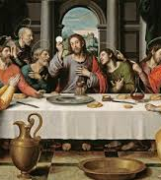
Proposed Solution #1:
Not the Passover
This view rests on the conjecture that such a preliminary ceremonial meal may have been celebrated in the days of Christ. This is possible but nothing exists to currently support it.

Slide 66
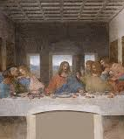
Proposed Solution #1:
Not the Passover
The more natural and obvious reading of these passages in their context points to the conclusion that the synoptic writers consistently and repeatedly speak of the Last Supper as “the passover. ’’ See Matt. 26:17, 20; Mark 14:12, 16, 17; Luke 22:7, 8, 13-15; cf. DA 642, 652; GC 399.

Slide 67
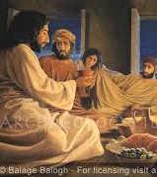
Proposed Solution #1:
Not the Passover
The comment of both Mark (eh. 14:12) and Luke (ch. 22:7), that the day preceding the Last Supper was “the first day of unleavened bread, when they killed the passover” (see Mark 14:12), would seem to preclude any possibility that the “passover” of the Synoptics could have been anything but a true Passover meal (cf. DA 642, 646, 652, 653; EW 165: GC 399).

Slide 68
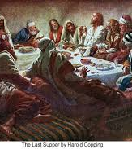
Proposed Solution #1:
Not the Passover
The disciples apparently took for granted that Thursday was the day of preparation for the Passover, that is, the day on which the paschal lamb should be slain and roasted.

Slide 69
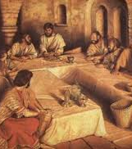
Proposed Solution #2:
STILL Not the Passover
Possibly “the passover” to which John refers was not the Passover meal, but a ceremonial meal connected with the Feast of Unleavened Bread. According to this assumption Friday was Nisan 15, and the Last Supper the preceding night was a celebration of the official Passover meal, at the regular time. This explanation is the reverse of the preceding one.

Slide 70
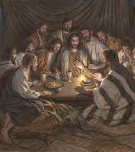
Proposed Solution #2:
STILL Not the Passover
This approach assumes that John uses the word “passover” in an accommodated sense. In favor of this view, it may be noted that common usage in NT times, as reflected by Josephus, commonly applied the term Passover to the combined celebration of the Passover and the Feast of Unleavened Bread.

Slide 71
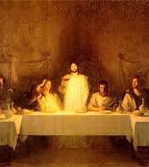
Proposed Solution #2:
STILL Not the Passover
But although it may be granted that John could have used the word “passover” in this accommodated sense, available evidence is strongly against his so doing in the passages cited:

Slide 72
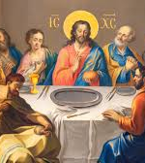
Proposed Solution #2:
STILL Not the Passover
There is no clear use of the word “passover” in this sense anywhere in the New Testament.

Slide 73
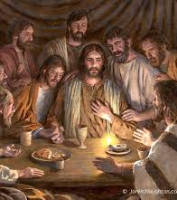
Proposed Solution #2:
STILL Not the Passover
The more natural and obvious reading of John’s statements in their context points to the conclusion that the Passover meal to which the apostle refers was the official celebration of the Passover, at least the one generally recognized by the Jewish leaders.

Slide 74
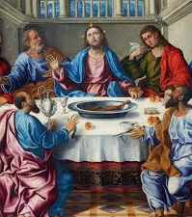
Proposed Solution #2:
STILL Not the Passover
The anxiety of the Jewish leaders to conclude the trial and execution of Jesus immediately, before the feast, in order to avoid delaying the case until after the feast, would appear to preclude any possibility that the feast had already begun (Matt. 26:3-5; Mark 14:1, 2, cf. DA 703).

Slide 75
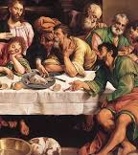
Proposed Solution #2:
STILL Not the Passover
Jewish law, as later codified in the Mishnah and the Talmud, prohibited the trial on a feast day of a case involving the death penalty or purchases such as that of the linen shroud and possibly also of spices for embalming the body of Jesus.

Slide 76
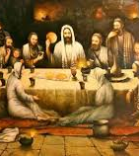
Proposed Solution #2:
STILL Not the Passover
The violation of these regulations — if they were in force in earlier times, as seems probable, and if, indeed, heed was given to them, which cannot be established — would seem to rule out the possibility that the arrest, trial, and crucifixion took place on Nisan 15, the first day of the Feast of Unleavened Bread and a ceremonial sabbath.

Slide 77
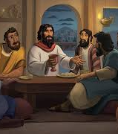
Proposed Solution #2:
STILL Not the Passover
Preparations for embalming the body of Jesus (Luke 23:54 to 24:1), such as the women made on the day of the crucifixion, were considered labor, and as such would seem to be inappropriate even for a ceremonial sabbath

Slide 78
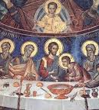
Proposed Solution #2:
STILL Not the Passover
At sunset of the crucifixion day the women “rested the sabbath day according to the commandment” (Luke 23:56), obviously a reference to the Sabbath of the fourth commandment.

Slide 79
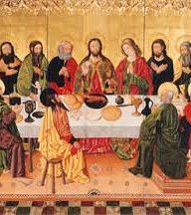
Proposed Solution #2:
STILL Not the Passover
If, as this view assumes, tire crucifixion fell on Nisan 15, the first day of unleavened bread, then the resurrection fell on Nisan 17, or the third day. But the offering of the first fruits, a type of the resurrection of our Lord, took place on hre second day, or Nisan 16. According to this view, then, the resurrection did not occur at the time called for by the ceremonial type of the wave sheaf.

Slide 80
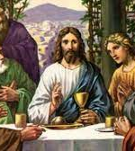
Proposed Solution #2:
STILL Not the Passover
In Jewish literature “the preparation of the passover” (John 19:14) is consistently applied to Nisan 14, never to Nisan 15, as this view would require.

Slide 81
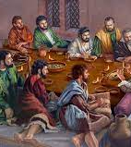
Proposed Solution #2:
STILL Not the Passover
“ The Passover was observed [by the Jews generally] as it had been for centuries [in other words, during the early hours of Nisan 15], while He to whom it pointed had been slain by wicked hands [late on Nisan 14], and lay in Joseph’s tomb” (DA 774; cf. GC 399).

Slide 82
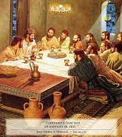
Proposed Solution #3:
A Jesus-Only Passover
That the Last Supper was a true Passover meal, as in the Synoptics, even though celebrated only by Jesus and His disciples, 24 hours in advance of the official Passover meal referred to by John, and thus of the time other Jews celebrated it. According to this assumption Friday was Nisan 14.

Slide 83
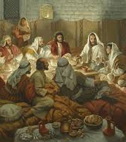
Proposed Solution #3:
A Jesus-Only Passover
The view that the Last Supper, although a true paschal meal, took place 24 hours prior to the time when the Jews, generally, celebrated it assumes that such a practice was possible.

Slide 84
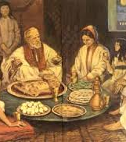
Proposed Solution #3:
A Jesus-Only Passover
This view, unlike the preceding one, does take into account the fact that the crucifixion occurred in fulfillment of the type provided by the slaying of the paschal lamb on Nisan 14. It was, admittedly, impossible for Christ to eat the paschal lamb at the usual time, and also, as Himself the true paschal Lamb,

Slide 85
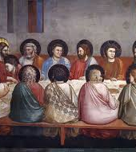
Proposed Solution #3:
A Jesus-Only Passover
to be slain at the usual time for the slaying of the Passover lambs. It would seem more important that His death should synchronize with the death of the Passover lambs than that His eating of the Passover should synchronize with the official time for eating that meal (pp. 533, 534; GC 399).

Slide 86
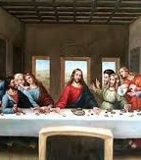
Proposed Solution #3:
A Jesus-Only Passover
Accordingly, His eating of the Passover would take place earlier than the time regularly set for it if the types of the slaying of the lamb and the offering of the first fruits were to be fulfilled “not only as to the event, but as to the time” (GC 399). However, this view is also confronted with difficulties.

Slide 87

Proposed Solution #3:
A Jesus-Only Passover
It is difficult to see how Jesus and tire disciples, as sole exceptions to the rule, could have celebrated the Passover a day in advance of the usual time. Note that:

Slide 88

Proposed Solution #3:
A Jesus-Only Passover
There is no historical evidence of anyone else having ever eaten the Passover early. The Passover lambs were to be slain at the Temple at a specified time, and, consistently as far as the record goes, there was no provision for slaying them at any other time than the late afternoon of Nisan 14.

Slide 89

Proposed Solution #3:
A Jesus-Only Passover
The disciples apparently recognized Thursday as the day on which preparations for the Passover should properly be made, in the crucifixion year (see Matt 26:17; Luke 22:7), and seemed to take for granted that Thursday night was the proper time for eating the paschal meal.

Slide 90

Proposed Solution #3:
A Jesus-Only Passover
Whether the subject had been under discussion and Jesus had informed them that the time of celebration would be an exception and come on Thursday rather than Friday night, or whether they considered that Thursday night was a normal time for the celebration, we are not informed. The synoptic writers are silent as to anything out of the ordinary about the eating of the Passover on Thursday night by Jesus and the disciples.

Slide 91

Proposed Solution #4:
Double Passovers
In the time of Christ sectarian differences with respect to calendrical reckoning, as to whether Nisan 14 and 16 should be correlated with certain days of the week, had led, in actual practice, to a celebration of the Passover on two successive days, that is, a double celebration.

Slide 92

Proposed Solution #4:
Double Passovers
According to this assumption, one religious faction (the Pharisees and other conservatives) would have considered that Nisan 14 fell on Thursday in the crucifixion year, and the other (the Boethusian Sadducees and other liberals), that it fell on Friday.

Slide 93
Proposed Solution #4:
Double Passovers
“
There are a number of variations to this idea:
  By spreading this out over two days, this would help the priests perform the needed sacrifices. Hoehner (an evangelical theologian) explains, “There arose the custom where the Galileans slew their lambs on Nisan 13, and the Feast of Unleavened Bread lasted eight days whereas the Judeans celebrated on Nisan 14.”[11]
”

Slide 94
Proposed Solution #4:
Double Passovers
“
He writes, “It is thought that the Galileans used a different method of reckoning the Passover than the Judeans. The Galileans and Pharisees used the sunrise-to-sunrise reckoning whereas the Judeans and Sadducees used the sunset-to-sunset reckoning.”[12] We can express these two groups succinctly:
”

Slide 95
Proposed Solution #4:
Double Passovers
“
  The Galilean Jews reckoned the day from sunrise-to-sunrise. This made the Last Supper a Passover meal. They had the Paschal lamb slaughtered in the afternoon on Thursday, Nisan 14. Carson writes, “The slaughter normally took place between 3.00 p.m. and 5.00 p.m. on 14 Nisan, falling on a Thursday in the year in question; Passover itself began about 6.00 p.m. on the same Thursday, the beginning of 15 Nisan.”[13]
”

Slide 96
Proposed Solution #4:
Double Passovers
“
  The Judean Jews reckoned the day from sunset-to-sunset. They would not have considered the Last Supper a Passover meal. They had their Paschal lamb slaughtered on Friday afternoon, Nisan 15. Under this calendar system, Jesus was eating the Passover meal when his enemies were conspiring to arrest him. In fact, they arrested him the night before.
”

Slide 97

Proposed Solution #4:
Double Passovers
Christ and the disciples thus, presumably, celebrated the Passover with the first group — the “passover” of the Synoptics — and the Jewish leaders celebrated it the following night — the “passover” of John. This assumption differs from the preceding one in that here Christ and the disciples were not alone in their celebration of the Passover.

Slide 98

Proposed Solution #4:
Double Passovers
The view that there was a double celebration of the Passover is based on one or another of various conjectures. What is perhaps the most plausible of these conjectures assumes that the “passover” of the Synoptics was the one celebrated by the Pharisees and other conservative Jews,

Slide 99

Proposed Solution #4:
Double Passovers
whereas that of John was the one observed by the more liberal Boethusian Sadducees and others sympathetic with their interpretation of Scripture. (The Boethusian Sadducees of Christ’s day are known to have contended that the “sabbath” of Lev. 23:1 1 referred to a weekly Sabbath instead of a ceremonial sabbath.)

Slide 100

Proposed Solution #4:
Double Passovers
Those who set forth this view conjecture that in a year like A.D. 3 1 , when, they assume, Nisan 1 6 would normally have fallen on the weekly Sabbath, the Sadducees would advocate the adjustment of the Jewish lunar calendar to make Nisan 16 fall, instead, on the first day of the week.

Slide 101

Proposed Solution #4:
Double Passovers
This could, it is granted, have given rise to a double celebration of the Passover, but there is no evidence that, in actual practice, it ever did so.

Slide 102

Proposed Solution #4:
Double Passovers
However, in that it makes the “passover” of the Synoptics and that of John both valid occasions for the celebration of the Passover, theory offers a possible solution of the apparently contradictory statements of the various gospel writers.

Slide 103

The Last Supper
We have here an instance where our present-day ignorance of ancient Jewish practices appears to be the cause of our inability clearly to harmonize the seemingly conflicting statements of John and the Synoptics.

Slide 104

The Last Supper
On the basis of all available evidence, but without accepting any one of these four proposed explanations, our SDA Bible Commentary suggests the possibility of the following sequence of events:

Slide 105
A Double Celebration
That in the year of the crucifixion, whether as a result of controversy between liberal and conservative elements of Judaism, or because of other circumstances now unknown, there may have been a double celebration of the Passover.
Thus harmonizing John and the other Gospel writers.

Slide 106
A True Celebration of Passover
That, with other conservative Jews, Christ and the disciples celebrated the Last Supper on Thursday night, during the early hours of what was officially Nisan 14, and that the Last Supper was a true celebration of the Passover.
Applying the phrasing of all Gospel writers in the most natural way.

Slide 107
An Anti-Typical Sacrifice
That Jesus died on the cross about the time of the evening sacrifice and the slaying of the paschal lambs, on Friday, Nisan 14.
Affirming EGW’s statements in GC 399.

Slide 108
Friday Night Passover
That, in the year of the crucifixion, the official celebration of the Passover came on Friday night, after the crucifixion.
Explaining the Jewish leaders’ urgency to finish the crucifixion.

Slide 109
A High Sabbath
That Jesus rested in the tomb over the weekly Sabbath, which, in that year, coincided with the ceremonial, or annual, sabbath, Nisan 15, the first day of the Feast of Unleavened Bread.
This timing conforms to the apparent concerns of the Jewish leaders as well as the actions of the women.

Slide 110
The Anti-Typical Wave Sheaf
That Jesus arose from the tomb early on Sunday morning, Nisan 16, the day when the wave sheaf, which typified the resurrection, was presented in the Temple.
Flawlessly conforming to the typical example.

Slide 111
Pharisees
Saducees
Essenes
Sicarri
Herodians
Zealots
Hassideans
Priests
Elders
Levites
Sanhedrin
Scribes
Chief Priests
Rabbis
Jewish Sects, Groups, Positions

Slide 112
From the morning of Nissan 14 until the end of the festival of Passover--approximately eight days and eight hours--it is strictly forbidden to eat any leavened foods ("chametz") or anything containing the slightest trace of leaven. The deadline for eating chametz is two "seasonal hours" before midday.
Jewish Rules for Passover

Slide 113
When Nissan 14 falls on Shabbat--as it does this year--the Shabbat services and the Shabbat morning meal are held early in the day, so that the Shabbat meal, which requires two challah loaves (which are chametz), can be concluded before the deadline.
Jewish Rules for Passover

Slide 114
Make sure that you eat all the chametz that has been left for Shabbat before the deadline, as chametz cannot be sold, burned, or taken out to the street, etc., on Shabbat.
Jewish Rules for Passover

Slide 115
For this reason, it is best to rid oneself of all chametz in one's possession before Shabbat, leaving only a small amount of challah for the Shabbat meal, and using kosher-for-Passover food and utensils for the rest of the meal. The remaining challah pieces and crumbs should be flushed down the toilet.
Jewish Rules for Passover

Slide 116
Recite the chametz nullification statement disavowing all ownership of any chametz you may have missed in the getting-rid-of-chametz process. The "nullification" should be said no later than one "proprtional hour" before midday.
Jewish Rules for Passover

Slide 117
Recite the chametz nullification statement disavowing all ownership of any chametz you may have missed in the getting-rid-of-chametz process. The "nullification" should be said no later than one "proportional hour" before midday.
Jewish Rules for Passover

Slide 118


Slide 119

One Exception:
Numbers 9:5-12
5 And they kept the passover on the fourteenth day of the first month at even in the wilderness of Sinai: according to all that the Lord commanded Moses, so did the children of Israel.

Slide 120

One Exception:
Numbers 9:5-12
6 And there were certain men, who were defiled by the dead body of a man, that they could not keep the passover on that day: and they came before Moses and before Aaron on that day:

Slide 121

One Exception:
Numbers 9:5-12
7 And those men said unto him, We are defiled by the dead body of a man: wherefore are we kept back, that we may not offer an offering of the Lord in his appointed season among the children of Israel?

Slide 122

One Exception:
Numbers 9:5-12
8 And Moses said unto them, Stand still, and I will hear what the Lord will command concerning you.
9 And the Lord spake unto Moses, saying,

Slide 123
One Exception:
Numbers 9:5-12
10 Speak unto the children of Israel, saying, If any man of you or of your posterity shall be unclean by reason of a dead body, or be in a journey afar off, yet he shall keep the passover unto the Lord.

Slide 124

One Exception:
Numbers 9:5-12
11 The fourteenth day of the second month at even they shall keep it, and eat it with unleavened bread and bitter herbs.

Slide 125

One Exception:
Numbers 9:5-12
12 They shall leave none of it unto the morning, nor break any bone of it: according to all the ordinances of the passover they shall keep it.

Slide 126
Happily, it is not necessary to solve this problem in order to avail ourselves of salvation through “Christ our passover,” who was “sacrificed for us” (1 Cor. 5:7).
But we should still know what has been revealed to us!

Slide 127
Thank you!
Happy Sabbath!!

